Slide 1
Implementing the Stepwise Approach for Asthma Treatment Student’s Name: Institutional Affiliation:

Slide 2
Treatment Options for Asthma Patients
Short-acting beta-agonists (SABA) provide quick relief of asthma symptoms among all patients with asthma regardless of severity.
SABAs include proventil, proAir, pirbuterol (Maxair) levalbuterol (Xopenex) (Sobieraj & Baker, 2018).
Patients with intermittent asthma require SABA treatment only.
Inhaled corticosteroids (ICS) should be administered to patients with persistent asthma.
ICS include budesonide, beclomethasone, fluticasone, flunisolide, triamcinolone, mometasone (Sobieraj & Baker, 2018).
Retrieved from: https://www.spectrumnews.org/news/asthma-common-among-children-with-autism-developmental-disabilities/
Notes:
Short-acting beta-agonists (SABA) are used for quick relief of sudden asthma symptoms among all patients regardless of the severity of their asthma. SABAs are also used to prevent any form of exercise-induced bronchospasm. Short-acting beta-agonists are also an effective treatment for patients with intermittent asthma. On the other hand, patients with persistent asthma will require an anti-inflammatory drug since asthma is an inflammatory disease. Inhaled corticosteroids such as budesonide, beclomethasone, fluticasone, flunisolide, triamcinolone, mometasone are the ideal anti-inflammatory drugs for patients with persistent asthma (Sobieraj & Baker, 2018).

Slide 3
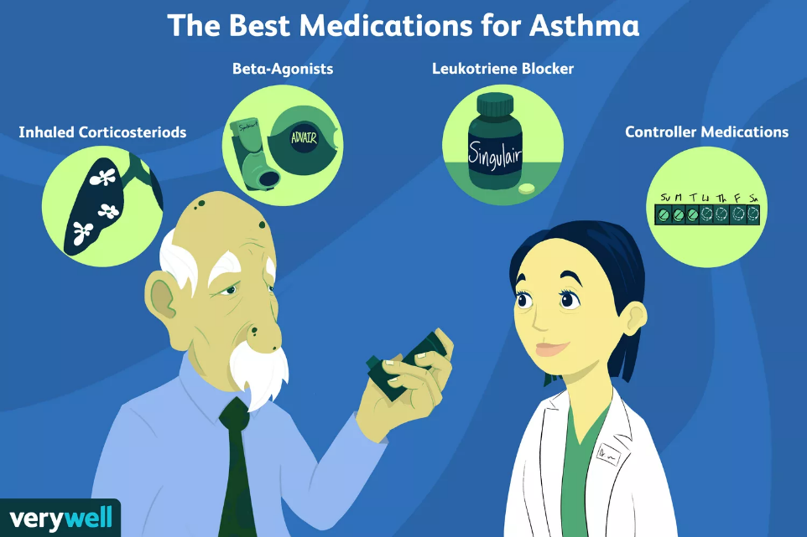
Treatment Options for Asthma Patients CONTD.
A combination of ICS and LABAs are used in the treatment of asthma patients with moderate and severe symptoms.
Allergic asthma is treated by leukotriene receptor antagonists (LTRAs) such as montelukast.
Severe asthma that is not controllable by ICS and LABAs is treated with immunomodulators such as omalizumab (Quirt et al., 2018).
Retrieved from: https://www.verywellhealth.com/what-is-the-best-medicine-for-asthma-82807
Notes:
A combination of long-acting beta-adrenergic (LABA) such as salmeterol and formoterol and corticosteroids are an effective treatment for moderate and severe persistent asthma. A combination of LABAs and ICS is therefore inhaled twice daily to manage moderate and severe persistent asthma. Leukotriene receptor antagonists (LTRAs) such as montelukast are administered in the management of allergic asthma. Severe asthma that is not controllable by inhaled corticosteroids and long-acting beta-adrenergic (LABA) is treated with immunomodulators such as omalizumab (Quirt et al., 2018).

Slide 4
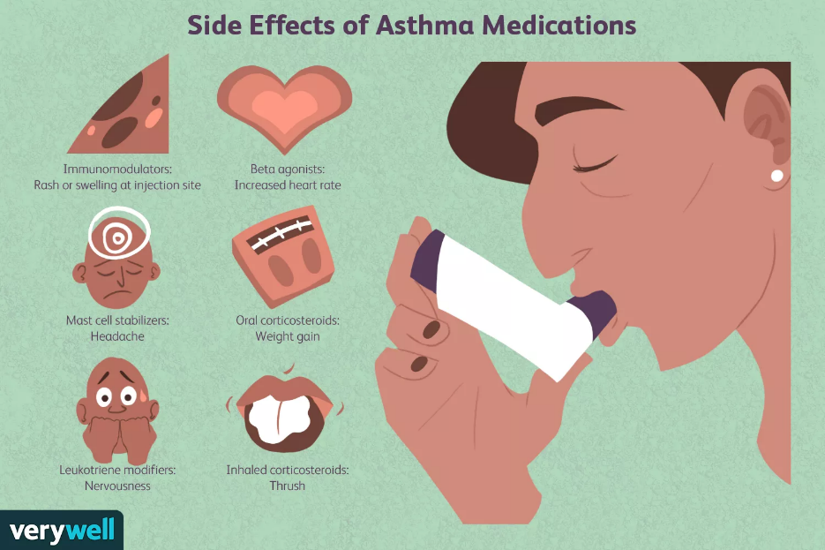
Side Effects of Asthma Drugs on Patients
Common side effects of SABAs Include anxiety, headache, and dizziness, diarrhea, vomiting and nausea, tremor, or nervousness.
Common side effects associated with ICS include bruising and cataracts, a decrease in bone mineral density, and skin thinning.
The side effects of LABAs include headache, tremor, and palpitations
The side effects of LTRAs include headache, upper respiratory tract infection, pharyngitis, fatigue, and gastrointestinal disorders (Sobieraj & Baker, 2018).
Retrieved from:https://www.verywellhealth.com/asthma-medication-side-effects-200593
Notes:
The various classes of asthma drugs might cause a wide range of mild to severe symptoms in patients. Short-acting beta-agonists (SABA) might cause common side effects such as anxiety, headache and dizziness, diarrhea, vomiting, and nausea, tremor, or nervousness. However, patients who experience heart palpitations or skin rash should consult their doctor. On the other hand, common side effects associated with inhaled corticosteroids (ICS) include bruising and cataracts, a decrease in bone mineral density, and skin thinning. Long-acting beta-adrenergic (LABA) will cause severe side effects such as palpitations, headaches, and tremors. Finally, Leukotriene receptor antagonists (LTRAs) are associated with side effects on patients such as headache, upper respiratory tract infection, pharyngitis fatigue, and gastrointestinal disorders (Sobieraj & Baker, 2018).

Slide 5
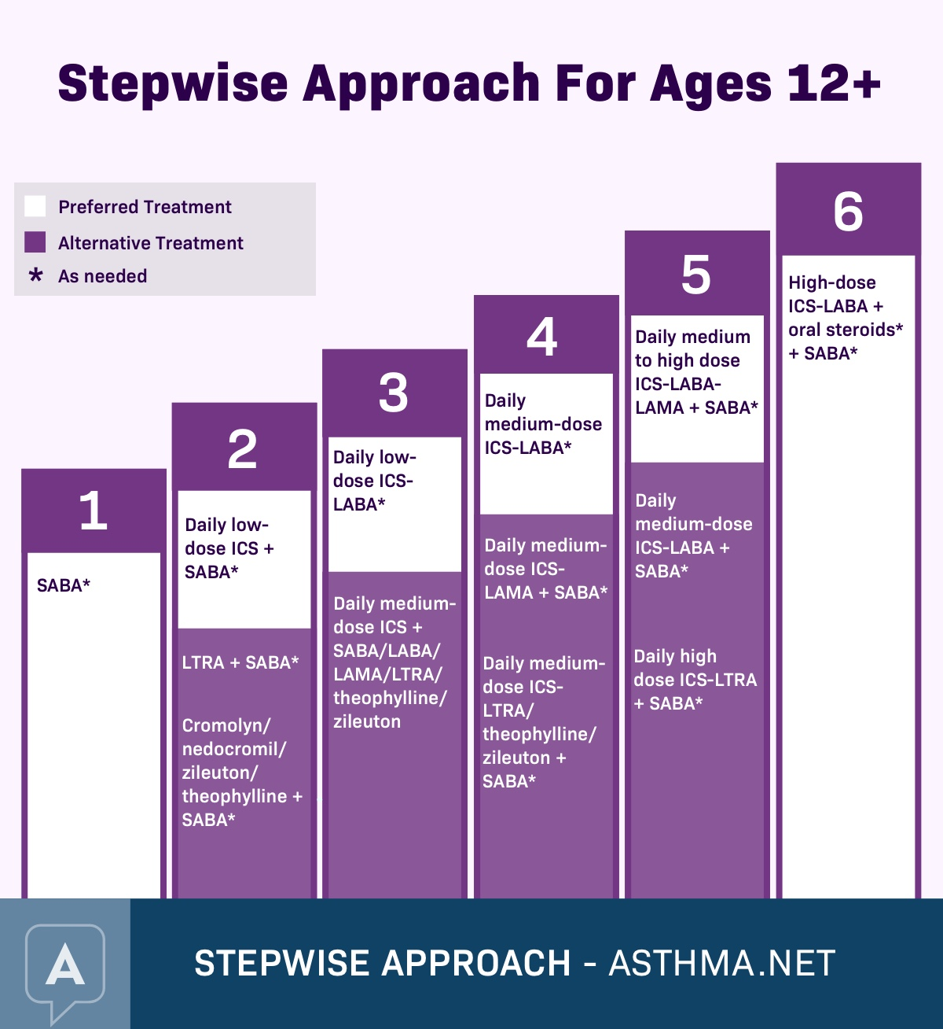
Stepwise Approach to Asthma Treatment and Management
Step 1
SABA Administration on patients with intermittent symptoms
Step 2
Low dose of ICS and SABA daily for patients with mild persistent asthma
Step 3
Low ICS combined with a LABA or an alternative of low dose ICS and LTRA (Papi et al., 2020).
Retrieved from:https://asthma.net/treatment/prevention
Notes:
The stepwise management of asthma is important to the effective treatment and management of the condition among patients above 12 years old. The first step involves the administration of short-acting agonists because the patients will only have intermittent symptoms of asthma. The second step involves the introduction of a low dose of inhaled corticosteroids in combination with short-acting agonists among patients with mild persistent asthma. The third step involves either combining a low dose of inhaled corticosteroids and long-acting beta-adrenergic (LABA) to treat patients with persistent asthma or administering a medium dose. An alternative treatment of a low dose of inhaled corticosteroids and Leukotriene receptor antagonists (LTRAs) is also considered in the third step (Papi et al., 2020).

Slide 6
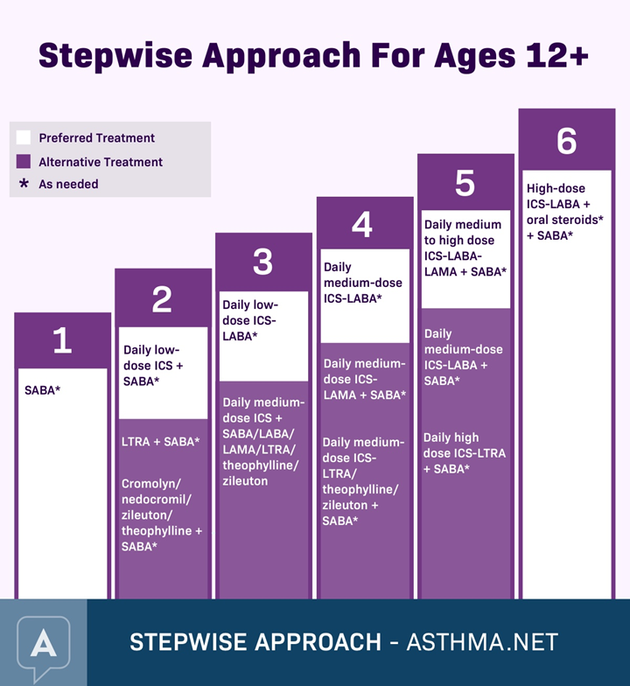
Stepwise Approach to Asthma Treatment and Management
Step 4
Medium doses ICS plus LABA or medium doses ICS plus LTRA.
Step 5
Preferred high doses ICS plus LABA and immunomodulators considered for patients with allergies.
Step 6
Preferred high dose of ICS plus oral corticosteroid plus LABA and immunomodulators considered for patients with allergies (Meghdadpour & Lugogo, 2018).
Retrieved from:https://asthma.net/treatment/prevention
Notes:
The fourth step involved administering a medium dose of inhaled corticosteroids and long-acting beta-adrenergic (LABA) on patients with persistent asthma. An alternative treatment of a medium dose of inhaled corticosteroids and Leukotriene receptor antagonists (LTRAs) can also be administered. The fifth step in the management of persistent asthma includes administering a high dose of inhaled corticosteroids and long-acting beta-adrenergic (LABA). An addition of immunomodulators is also considered for patients with allergies at this stage. The final step of management of persistent asthma involves administering a preferred high dose of inhaled corticosteroids, oral corticosteroids, and long-acting beta-adrenergic (LABA). The final stage and immunomodulatory might also be considered for patients with allergies (Meghdadpour & Lugogo, 2018).

Slide 7
Importance of Stepwise Management of Asthma for Healthcare Providers and Patients
Stepwise management of asthma helps to control asthma by reducing risk and managing the environment.
Stepwise management of asthma provides categories of information related to patient education for each step.
Stepwise management provides a definite time for healthcare providers to evaluate improvements in patients before escalating the treatment to the next step.
Notes:
Stepwise management plays a significant role in assisting both healthcare providers and patients to gain and maintain control over asthma. Stepwise management provides different interventions that can be utilized to educate patients on how to manage and avoid environmental triggers for their asthma. The stepwise management approach for asthma also provides a definite time of 2 to 6 weeks intervals in which healthcare providers can assess the improvement in a patient before recommending further treatment (Meghdadpour & Lugogo, 2018).

Slide 8
References
Meghdadpour, S., & Lugogo, N. L. (2018). Medication Regimens for Managing Stable Asthma. Respiratory Care, 63(6), 759–772. https://doi.org/10.4187/respcare.05957
Papi, A., Blasi, F., Canonica, G. W., Morandi, L., Richeldi, L., & Rossi, A. (2020). Treatment strategies for asthma: reshaping the concept of asthma management. Allergy, Asthma & Clinical Immunology, 16(1). https://doi.org/10.1186/s13223-020-00472-8
Quirt, J., Hildebrand, K. J., Mazza, J., Noya, F., & Kim, H. (2018). Asthma. Allergy, Asthma & Clinical Immunology, 14(S2). https://doi.org/10.1186/s13223-018-0279-0
Sobieraj, D. M., & Baker, W. L. (2018). Medications for Asthma. JAMA, 319(14), 1520. https://doi.org/10.1001/jama.2018.3808

